Slide 1

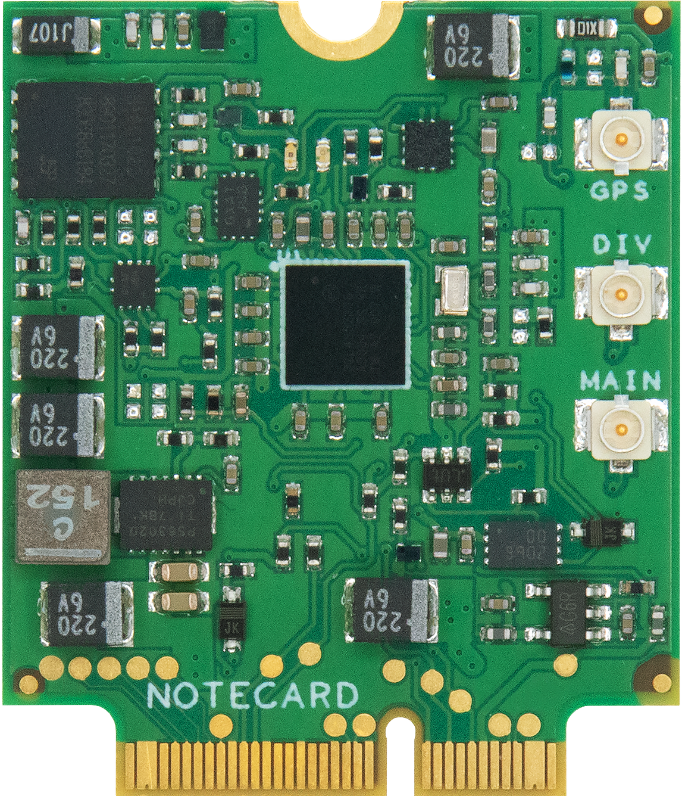
ML & Cloud Computing

Slide 2
Model Deployment
+
+
+
Notes:
Once we’ve built and trained our model, we often want to deploy it somewhere so we can call it. Most of this time, at least today, this is a Cloud-based endpoint hosted on Azure, AWS or Google. We can create a serverless function to host this endpoint, build a full app, or do whatever we like.

Slide 3

Pre-Trained models as APIs
Notes:
It’s important to note that the major Cloud providers also provide canned, pre-trained and tuned APIs that are available for us to call. For instance, Microsoft provides a number of these under the Azure Cognitive Services banner, including a Face API that includes emotion detection in the result. Let’s look at a demo of this now.

Slide 4
Using the Azure Face API
Demo
Notes:
It turns out the Azure Face API has an emotion detection component, let’s look at that now

Slide 5











Local Development, Cloud Training and Deployment
Define Task
Real time Inference Data
Local Development
?
Collect Data
Prepare Data
Maintain, Update & Refine
Training & Validation Data
Explore
Model
Train Model
Tune
& Refine
Test & Evaluate
Deploy Model
Cloud Training & Deployment
Notes:
So far, the delineation of where things happen in the ML process has been pretty straightforward. We develop models locally with local tools, train and refine those models in the cloud, and run inference by accessing Cloud-deployed endpoints.
But one thing we haven’t discussed yet is what systems call our ML system for predictions, and where the source data for predictions come from. As it turns out this is important, because the source of these mountains of data that we created ML systems to handle and kind of the reason this whole trend is happening.
It’s also the place where the cutting edge of ML work and opportunity lies...

